Slide 1

IoT Cloud Computing for Defense
Automating the Border Defense
Presentation by
A Trilochan Kumar – AP23122100009
MTech
in
Embedded Systems and Internet of Things
Department of Electronics and Communication Engineering
SRM University AP

Slide 2
Abstract
The idea is to reduce the manual work for Indian soldiers at border.
According to a research paper submitted at an annual police meet
India has lost access to 26 out of 65 patrolling points in eastern Ladakh.
The paper also states that the Indian Army's approach is to create buffer zones and restrict the movement of graziers along the China border.
So where, Indian soldiers cannot frequently monitor, we can deploy IoT devices connected to cloud, and monitor such zones with ease.

Slide 3
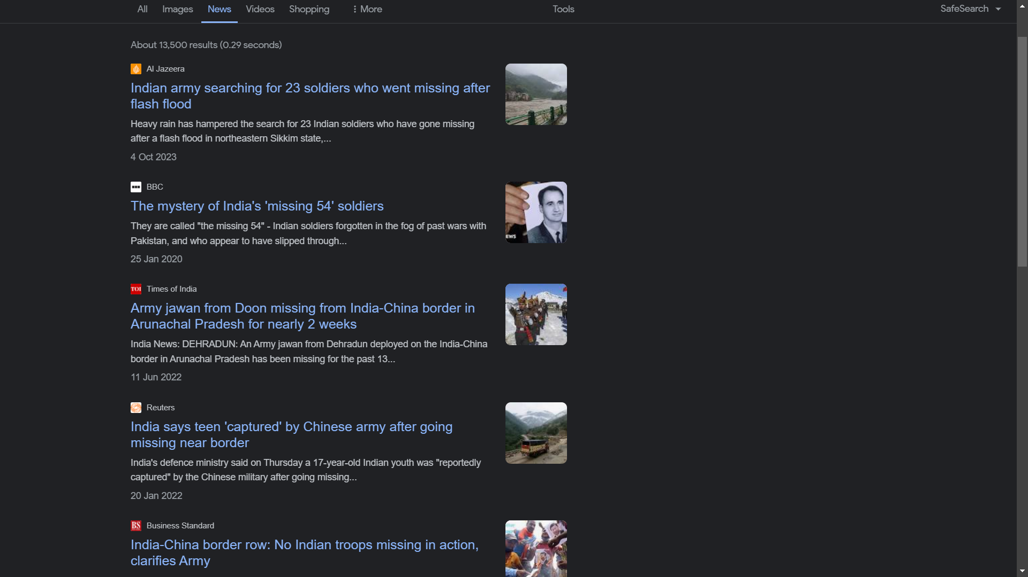
Situation at Indian Borders

Slide 4
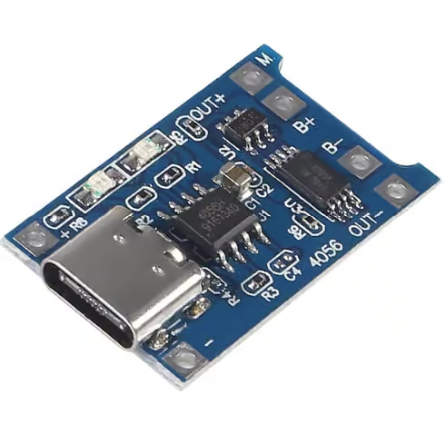
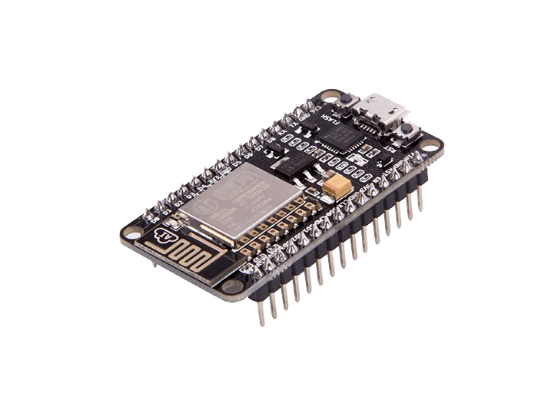
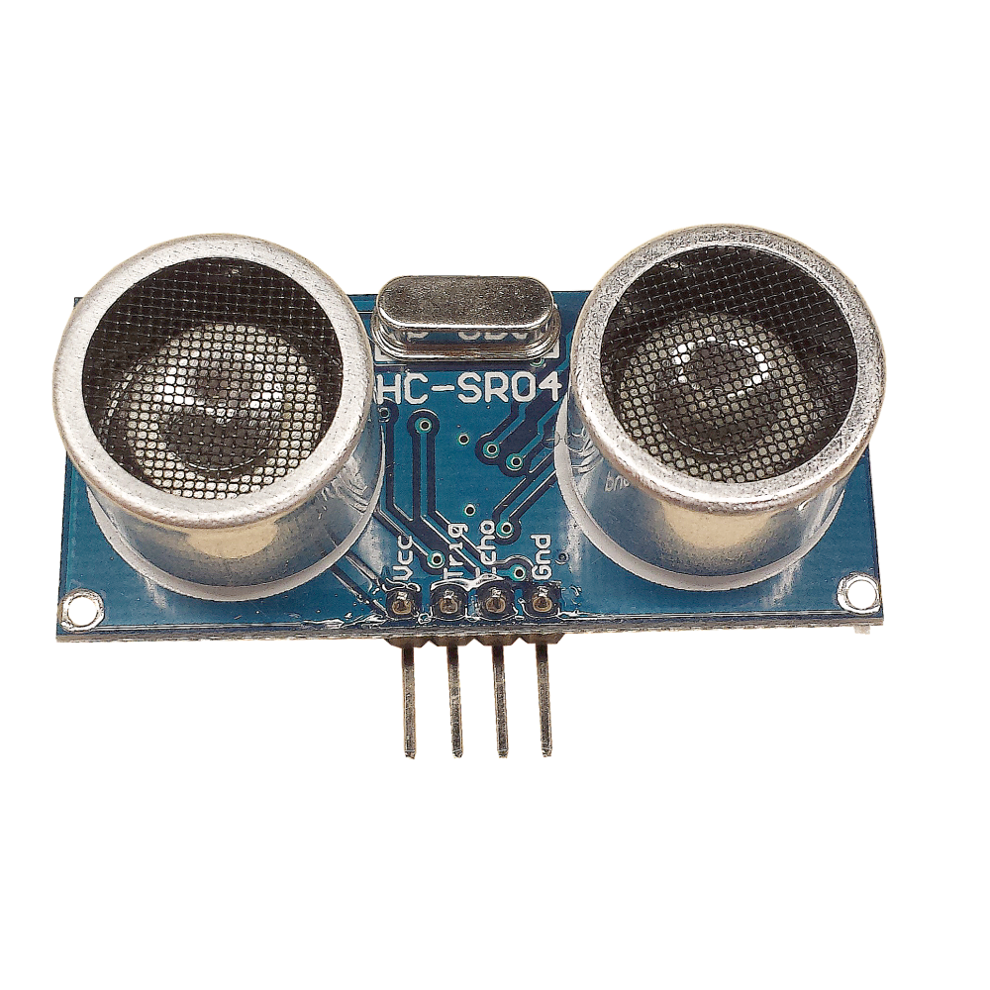
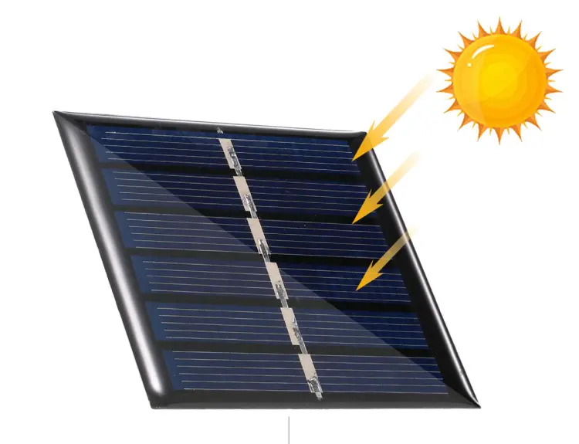
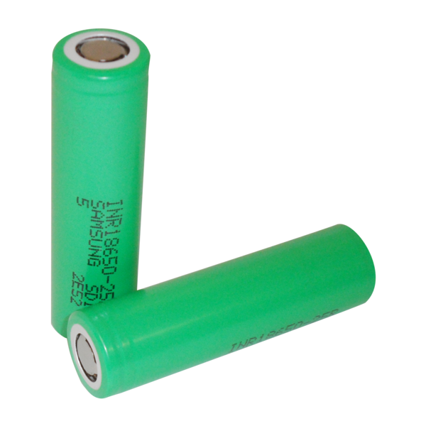
Use of IoT to Automate and Monitor Borders

Slide 5
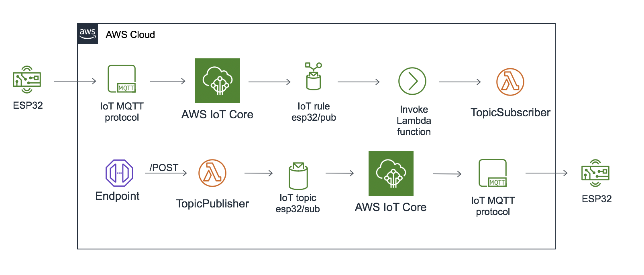
Methodology

Slide 6
Implementation
#include "secrets.h"
#include <WiFiClientSecure.h>
#include <PubSubClient.h>
#include <ArduinoJson.h>
#include "WiFi.h"
int trig = 9;
int echo = 13;
WiFiClientSecure net = WiFiClientSecure();
PubSubClient client(net);
#define AWS_IOT_PUBLISH_TOPIC "esp32/ultrasonic"
void connectAWS() {
WiFi.mode(WIFI_STA);
WiFi.begin(WIFI_SSID, WIFI_PASSWORD);
Serial.println("Connecting to Wi-Fi");
while (WiFi.status() != WL_CONNECTED) {
delay(500);
Serial.print(".");
}
// Configure WiFiClientSecure to use the AWS IoT device credentials
net.setCACert(AWS_CERT_CA);
net.setCertificate(AWS_CERT_CRT);
net.setPrivateKey(AWS_CERT_PRIVATE);
// Connect to the MQTT broker on the AWS endpoint we defined earlier
client.setServer(AWS_IOT_ENDPOINT, 8883);
Serial.println("Connecting to AWS IoT");
while (!client.connect(THINGNAME)) {
Serial.print("Connection failed, rc=");
Serial.print(client.state());
Serial.println(". Retrying...");
delay(5000);
}
if (!client.connected()) {
Serial.println("AWS IoT Timeout!");
return;
}
Serial.println("AWS IoT Connected!");
}
void publishMessage(float distance) {
StaticJsonDocument<200> doc;
doc["distance"] = distance; // Publish distance data
char jsonBuffer[512];
serializeJson(doc, jsonBuffer); // Serialize JSON
client.publish(AWS_IOT_PUBLISH_TOPIC, jsonBuffer); // Publish to
AWS IoT
}
void setup() {
pinMode(trig, OUTPUT);
pinMode(echo, INPUT);
Serial.begin(115200);
connectAWS(); // Connect to AWS IoT
}
void loop() {
digitalWrite(trig, HIGH);
delayMicroseconds(2);
digitalWrite(trig, LOW);
int duration = pulseIn(echo, HIGH);
float distance = (duration * 0.034) / 2;
Serial.print("Distance: ");
Serial.print(distance);
Serial.println(" cm");
publishMessage(distance); // Send distance data to AWS IoT
delay(1000);
}

Slide 7
Results
The further updates can be improving the security for the node.

Slide 8

Thank You

